Slide 1
Let’s play with
EASTER BUNNY

Slide 2
Can you HELP Easter Bunny?
READY…
STEADY…
GO!

Slide 4
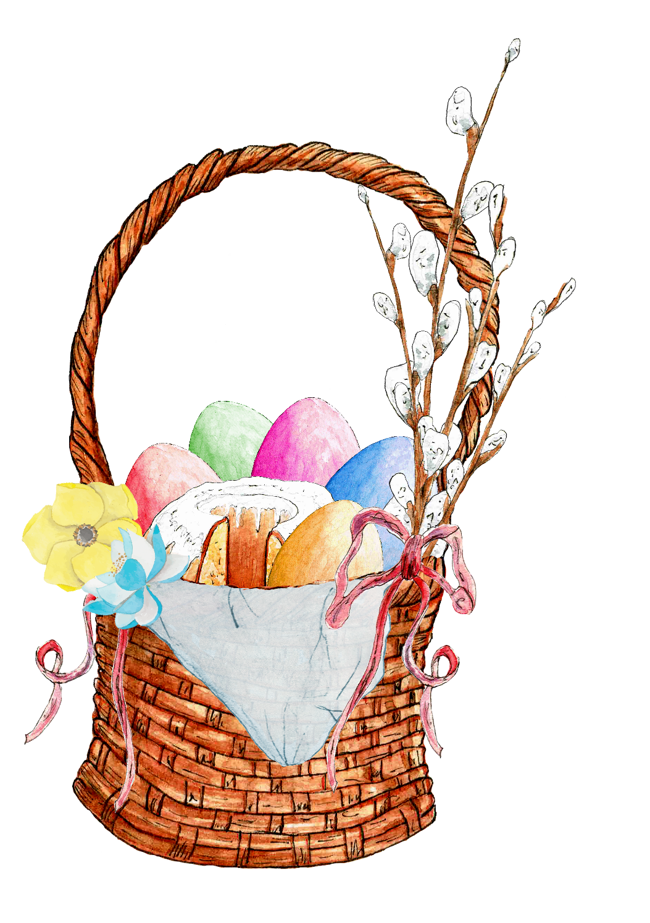
1, 2, 3, what can it be?

Slide 5
It’s an EASTER BASKET.

Slide 6
Do you remeber the code?

Slide 7
YOUR TURN !

Slide 8
WELL DONE!

Slide 9
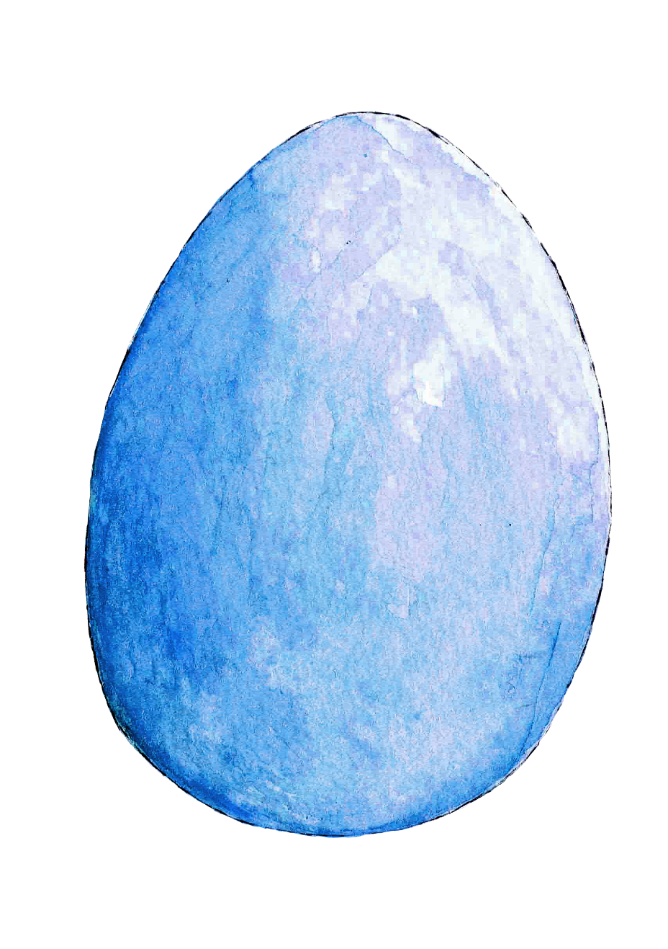
1, 2, 3, what can it be?

Slide 10
It’s an EASTER EGG.

Slide 11
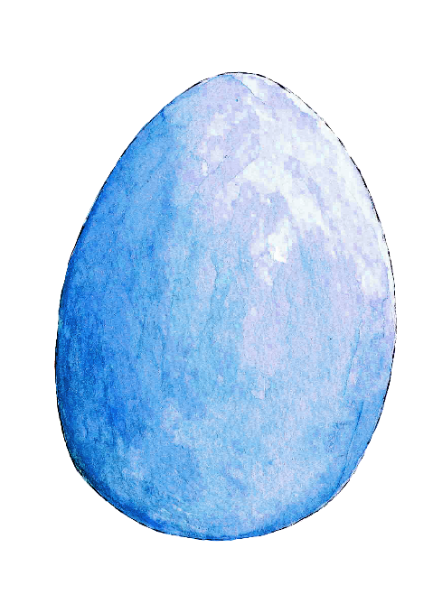
YOUR TURN !

Slide 12
WELL DONE!

Slide 13
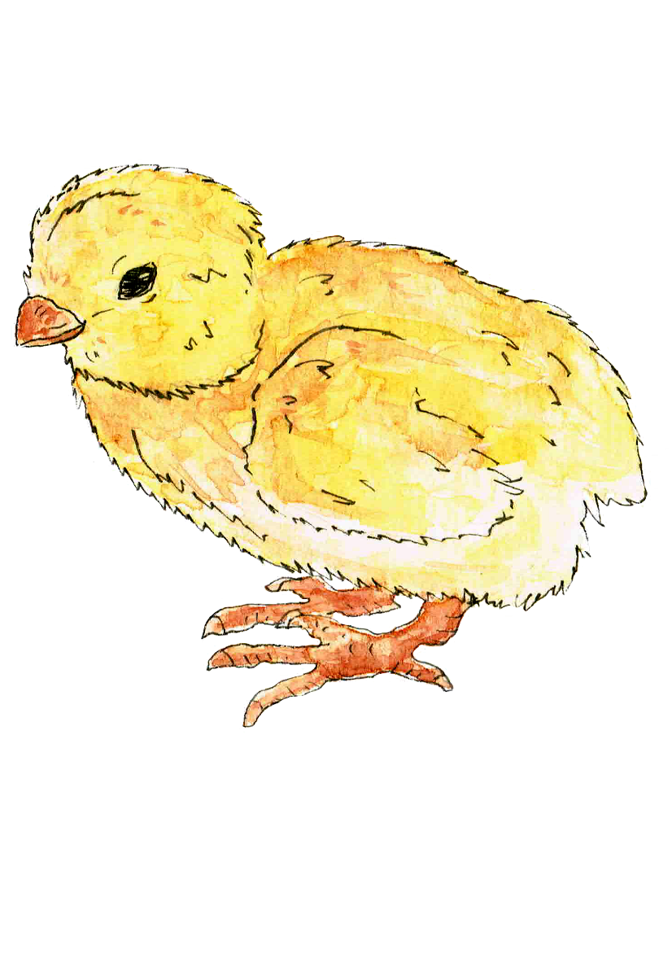
1, 2, 3, what can it be?

Slide 14
It’s an EASTER CHICK.

Slide 15
YOUR TURN !

Slide 16
WELL DONE!

Slide 17
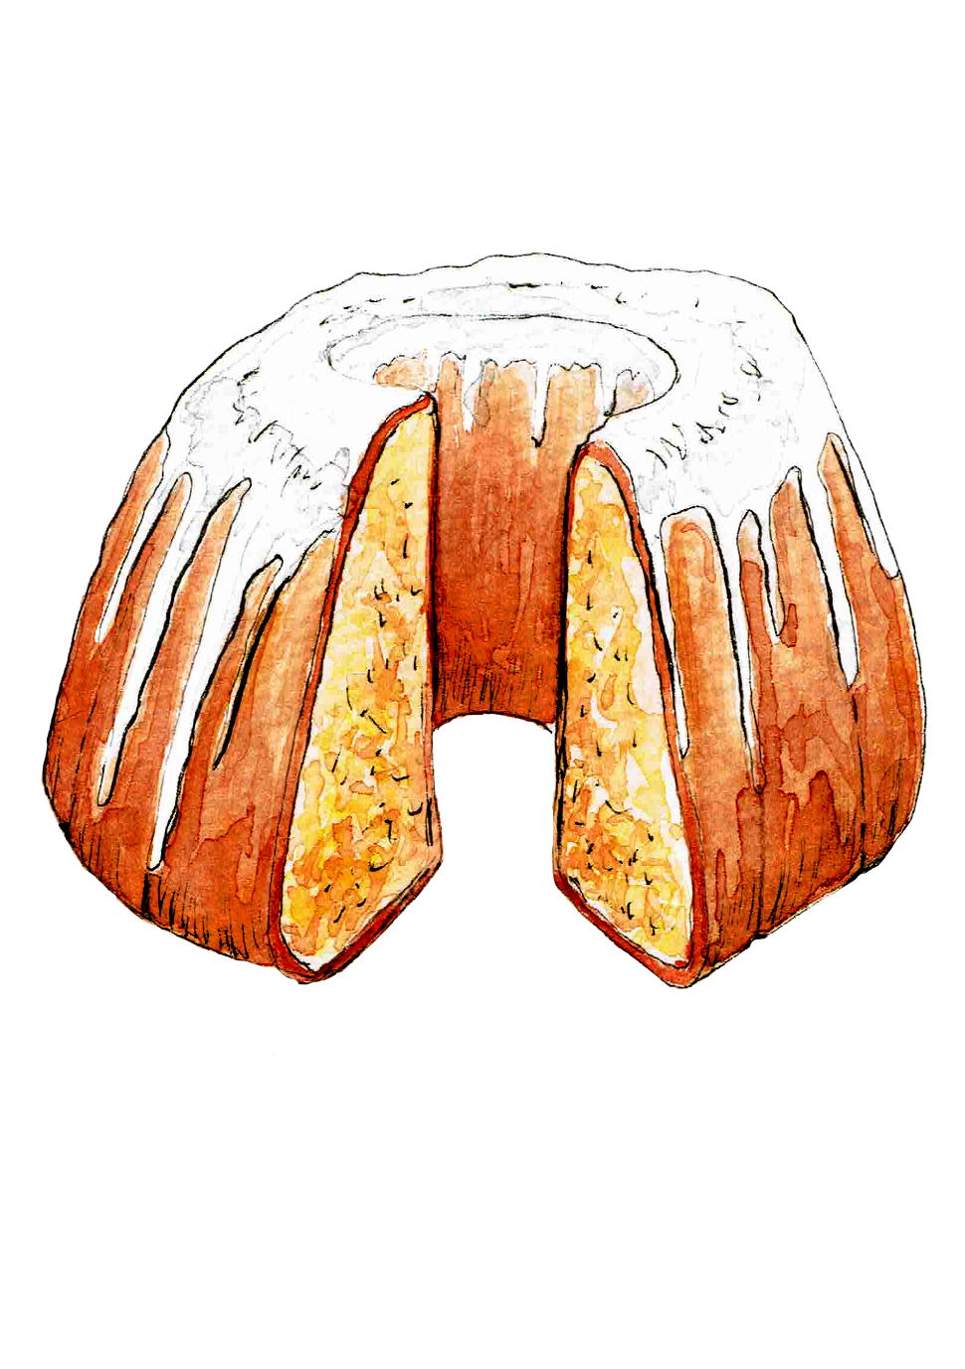
1, 2, 3, what can it be?

Slide 18
It’s an EASTER CAKE.

Slide 19
YOUR TURN !

Slide 20
WELL DONE!

Slide 21
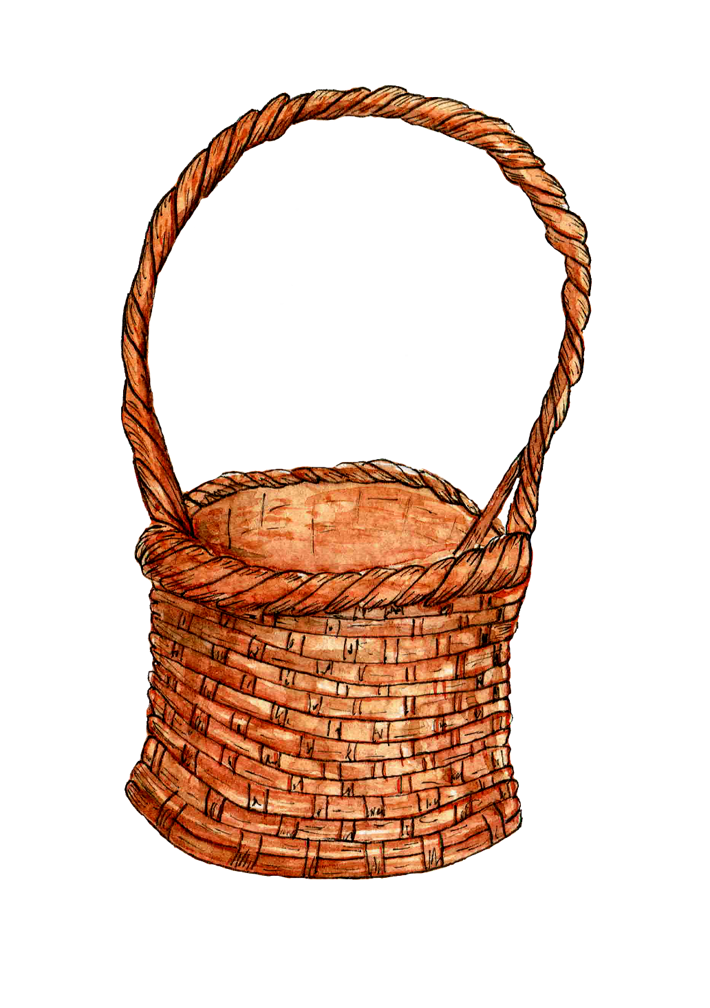
It’s a BASKET.

Slide 22
What can we put into the BASKET?
???
⬇

Slide 23
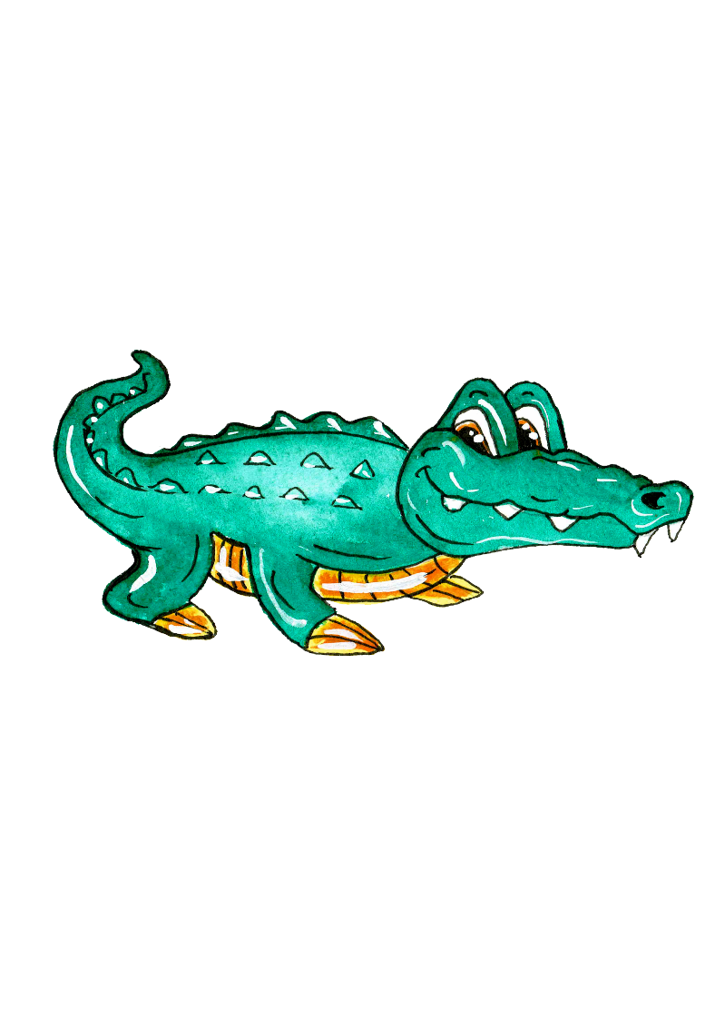
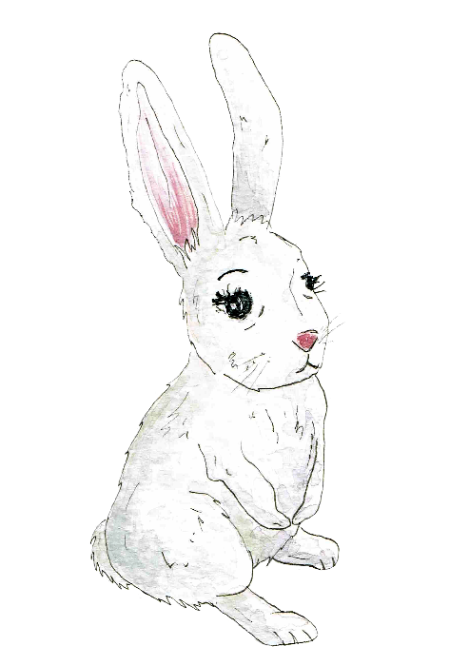
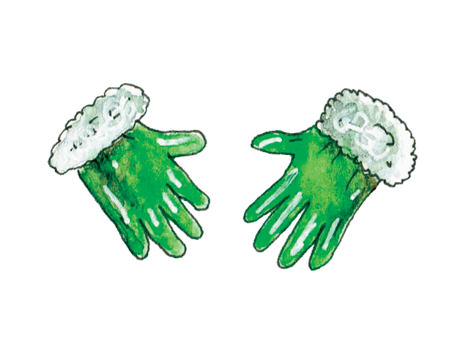

Slide 24
Great job!
THANK YOU!

